Slide 1
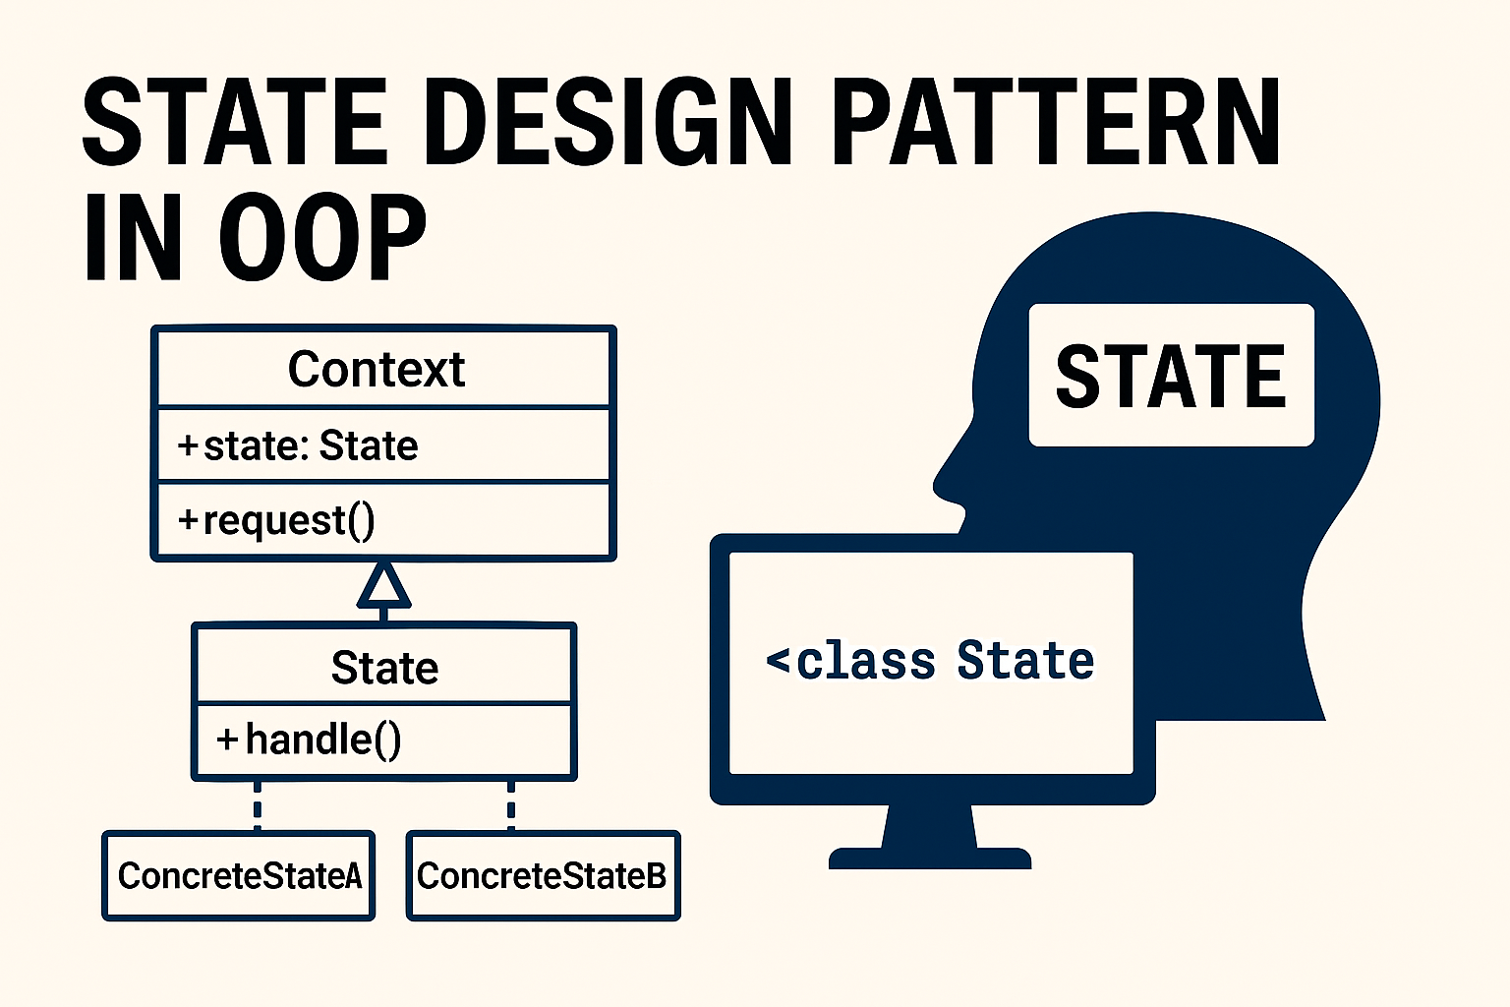
State Design Pattern
A Behavioural Design Pattern

Slide 2
State Design Pattern
A Behavioral pattern
The state pattern is primarily used when you need to change the behavior of an object based upon the state that it's in at run-time.

Slide 3


Slide 4
Creational (5)
Factory
Structural (7)
Adapter
Behavioral (11)
Chain Of Responsibility
Abstract Factory
Singleton
Prototype
Builder
Bridge
Composite
Decorator
Facade
Flyweight
Proxy
Command
Interpreter
Iterator
Mediator
Memento
Observer
State
Strategy
Template
Visitor

Slide 5
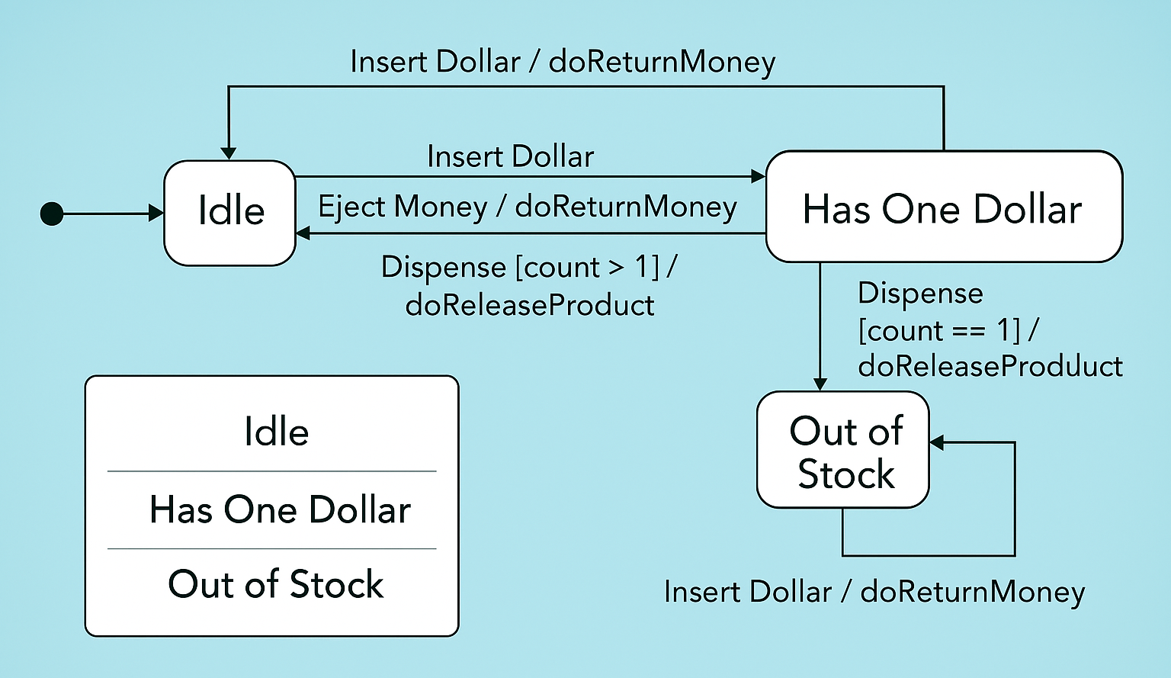

Slide 6
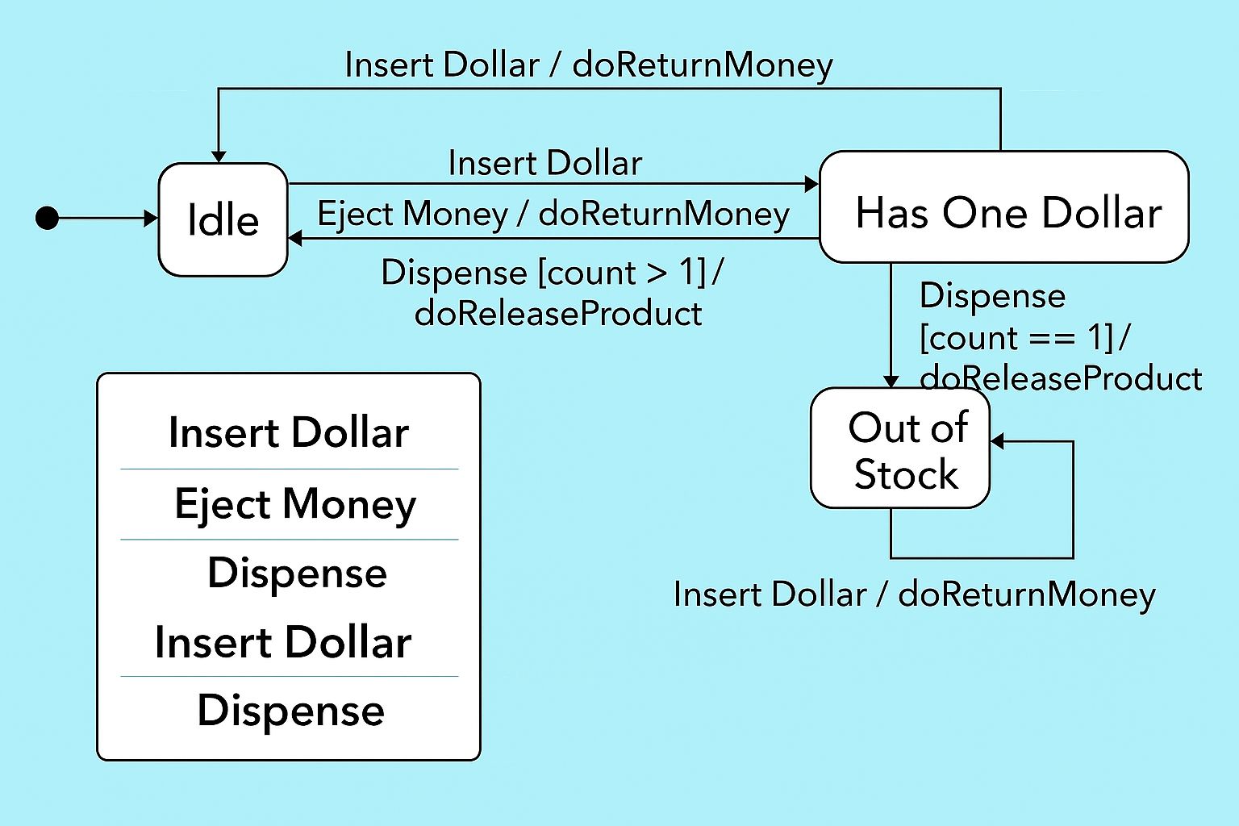

Slide 7
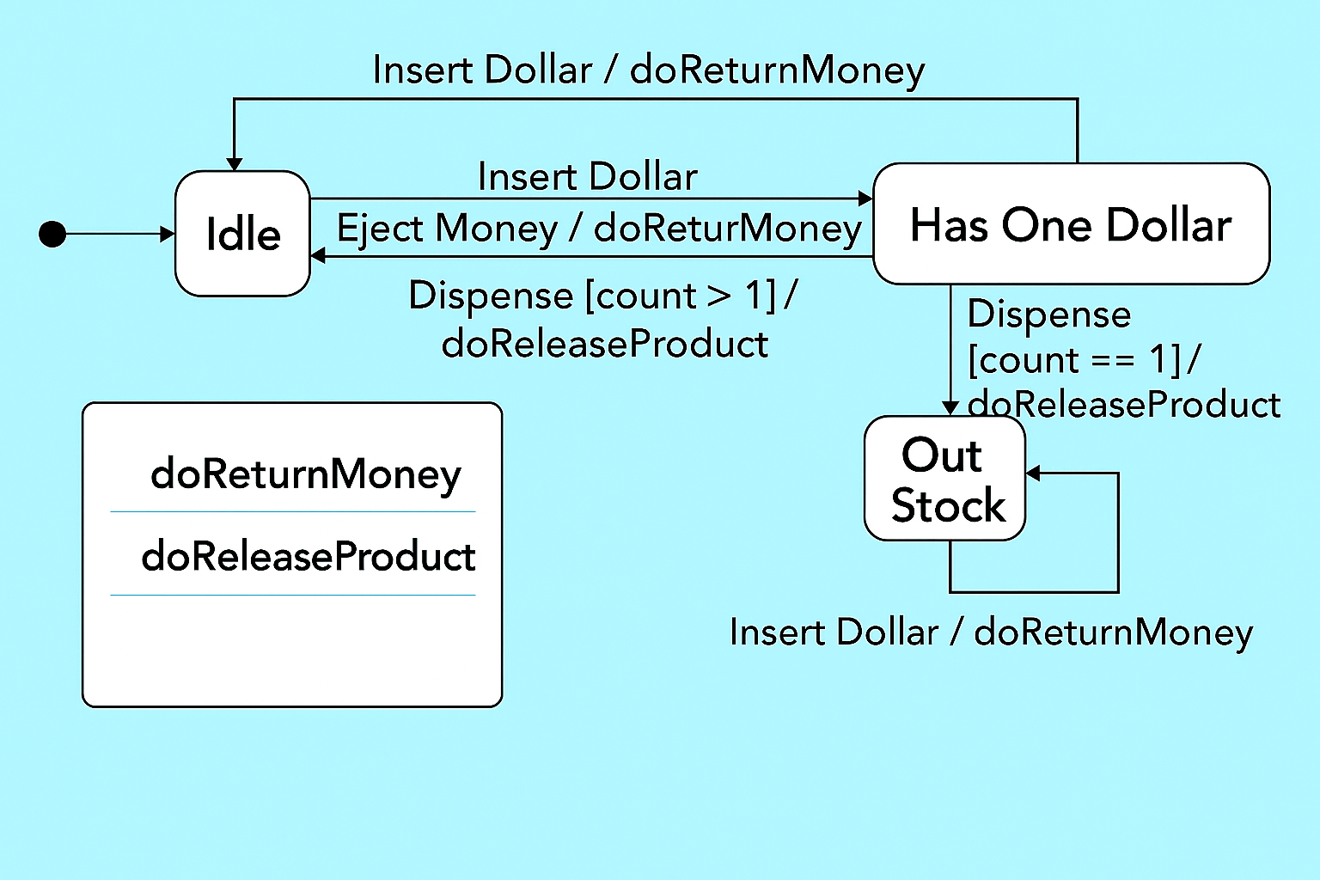

Slide 8
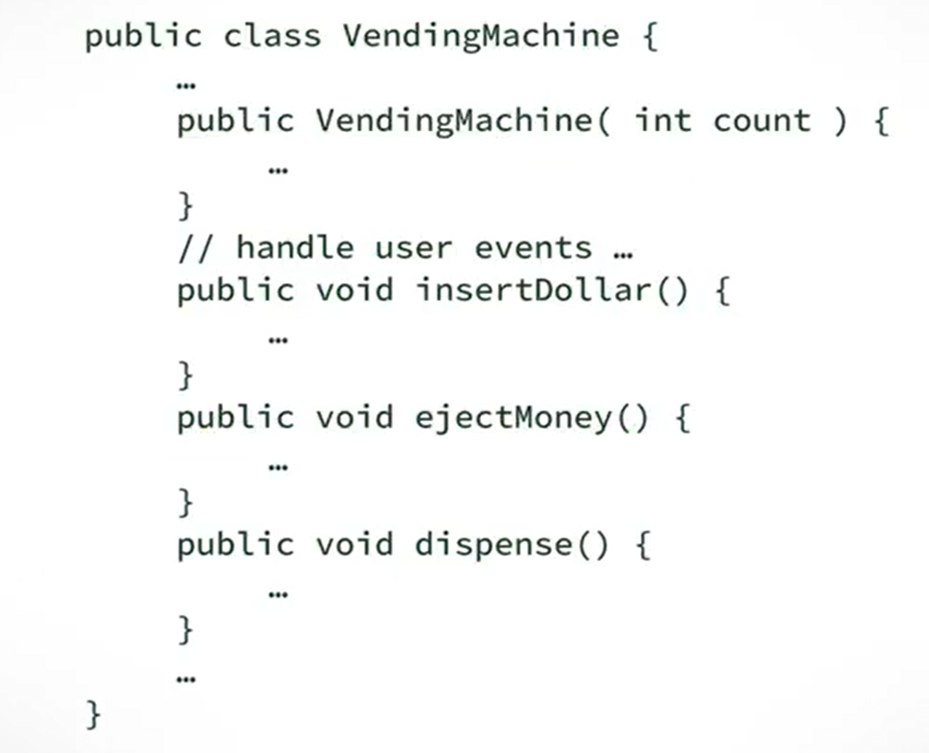

Slide 9
Traditional Implementation

Slide 10
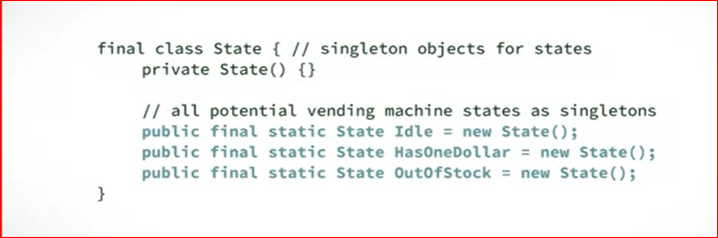

Slide 11
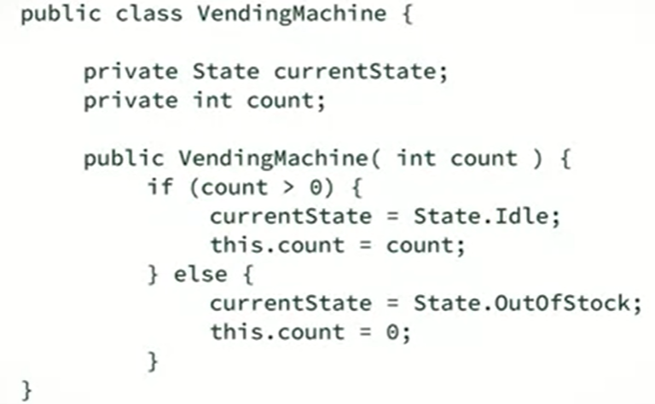

Slide 12
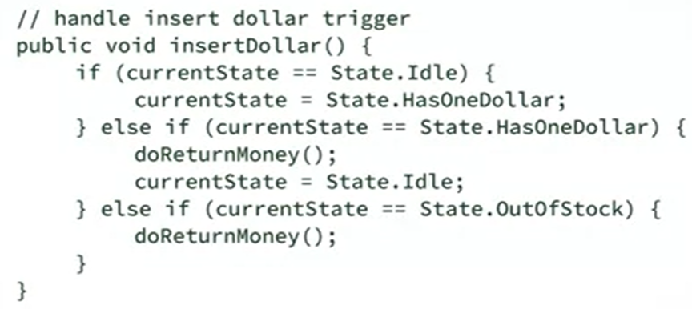

Slide 13
State Design Pattern

Slide 14
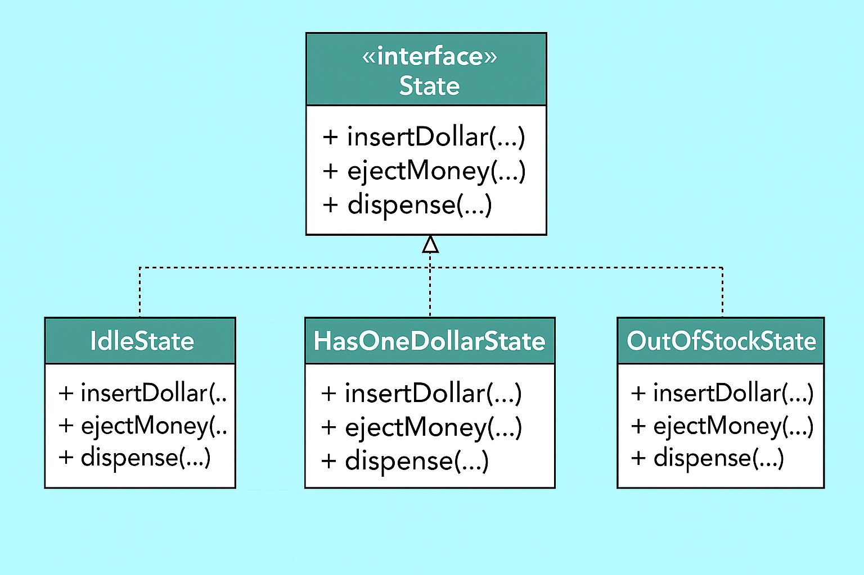

Slide 15
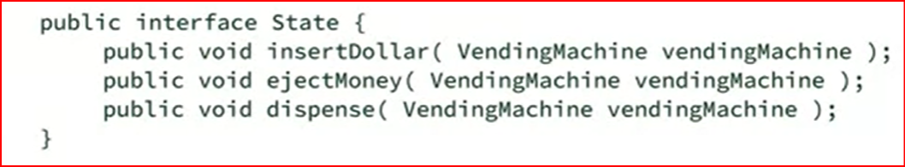

Slide 16
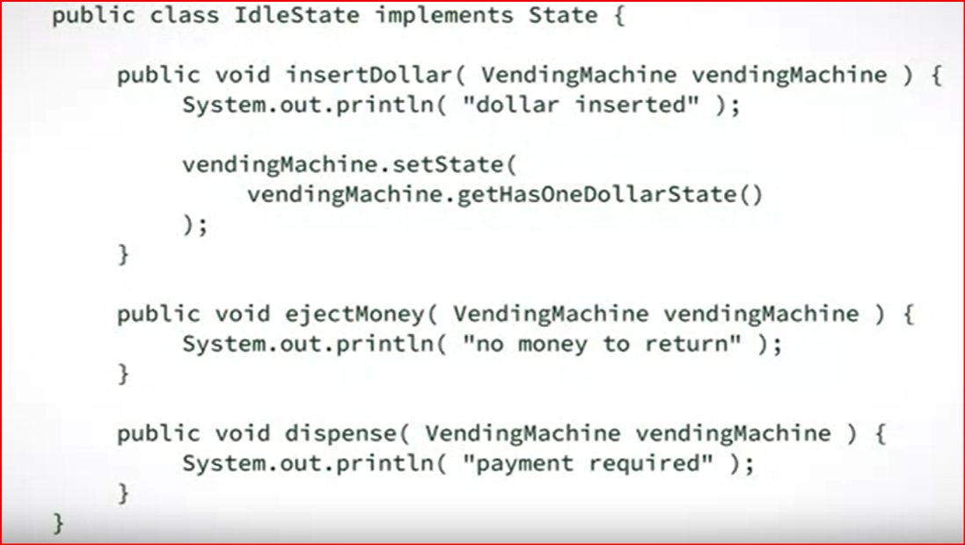

Slide 17
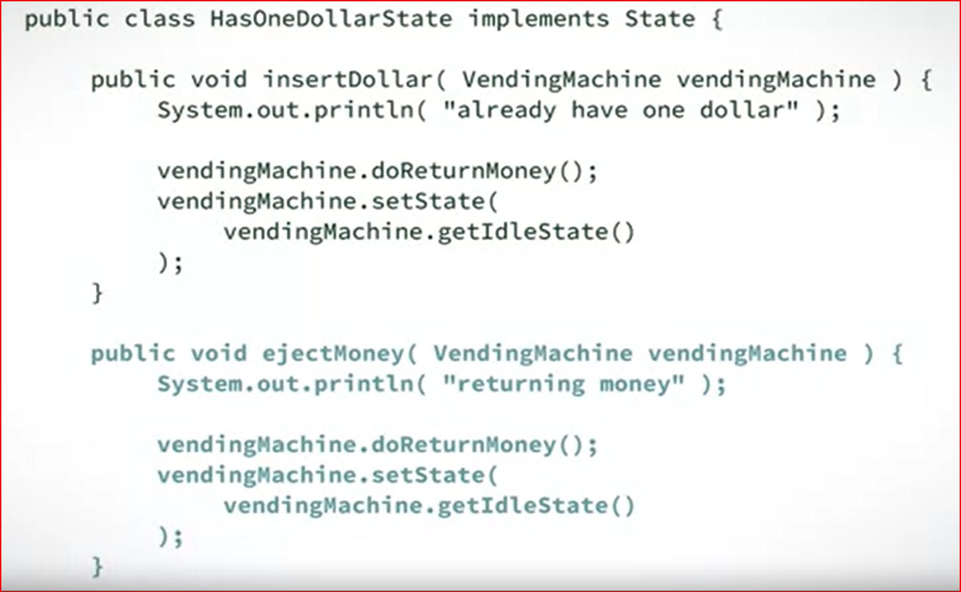

Slide 18
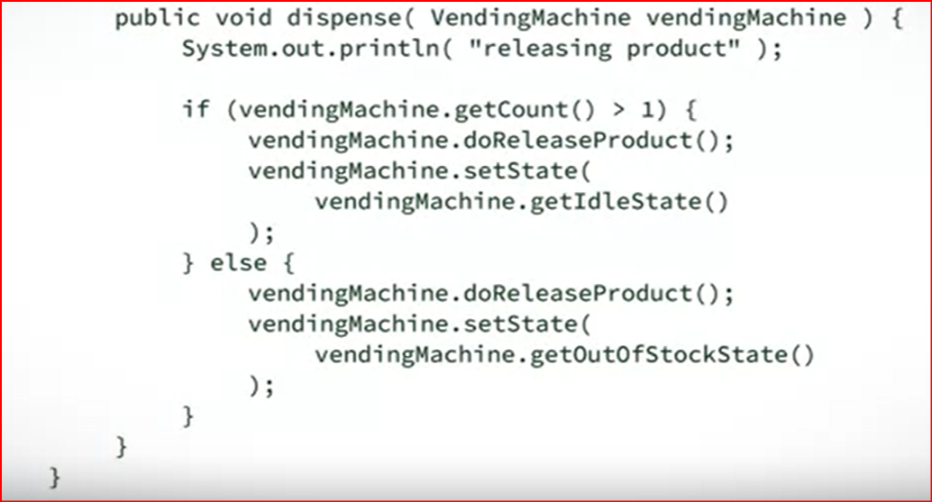

Slide 19
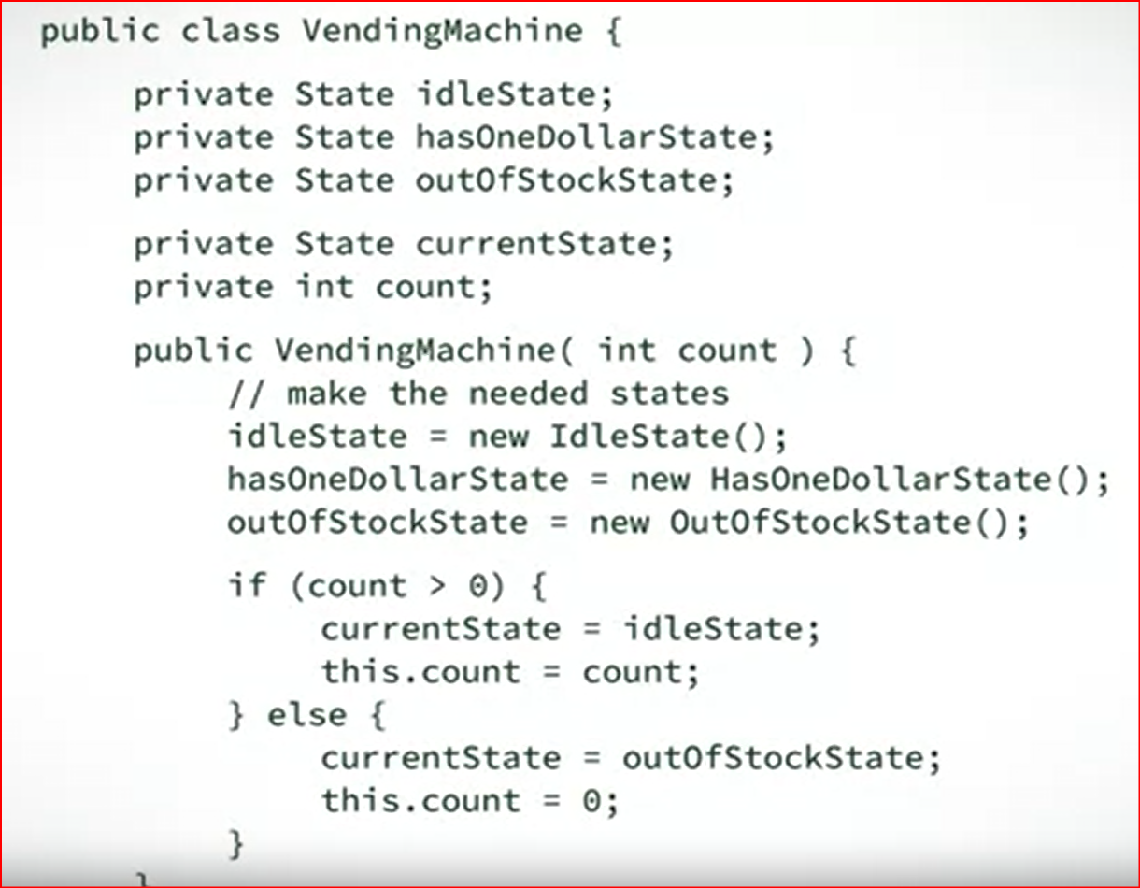

Slide 20
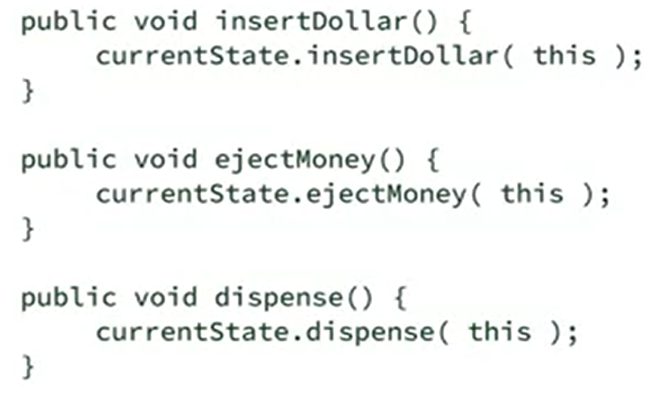

Slide 21
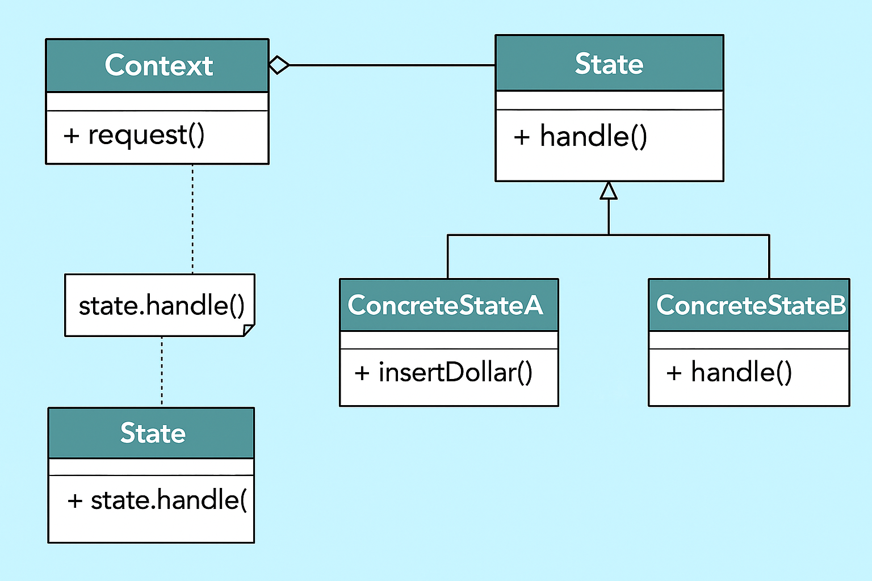

Slide 22

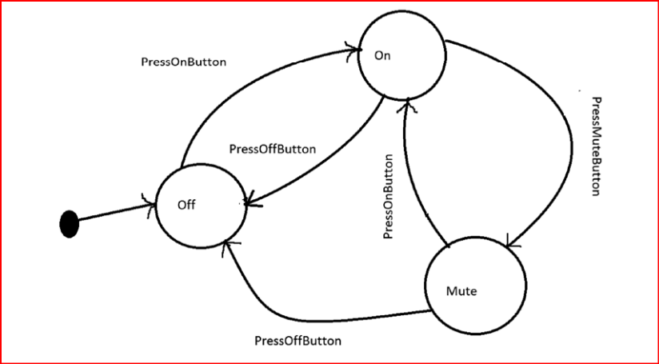

Slide 23
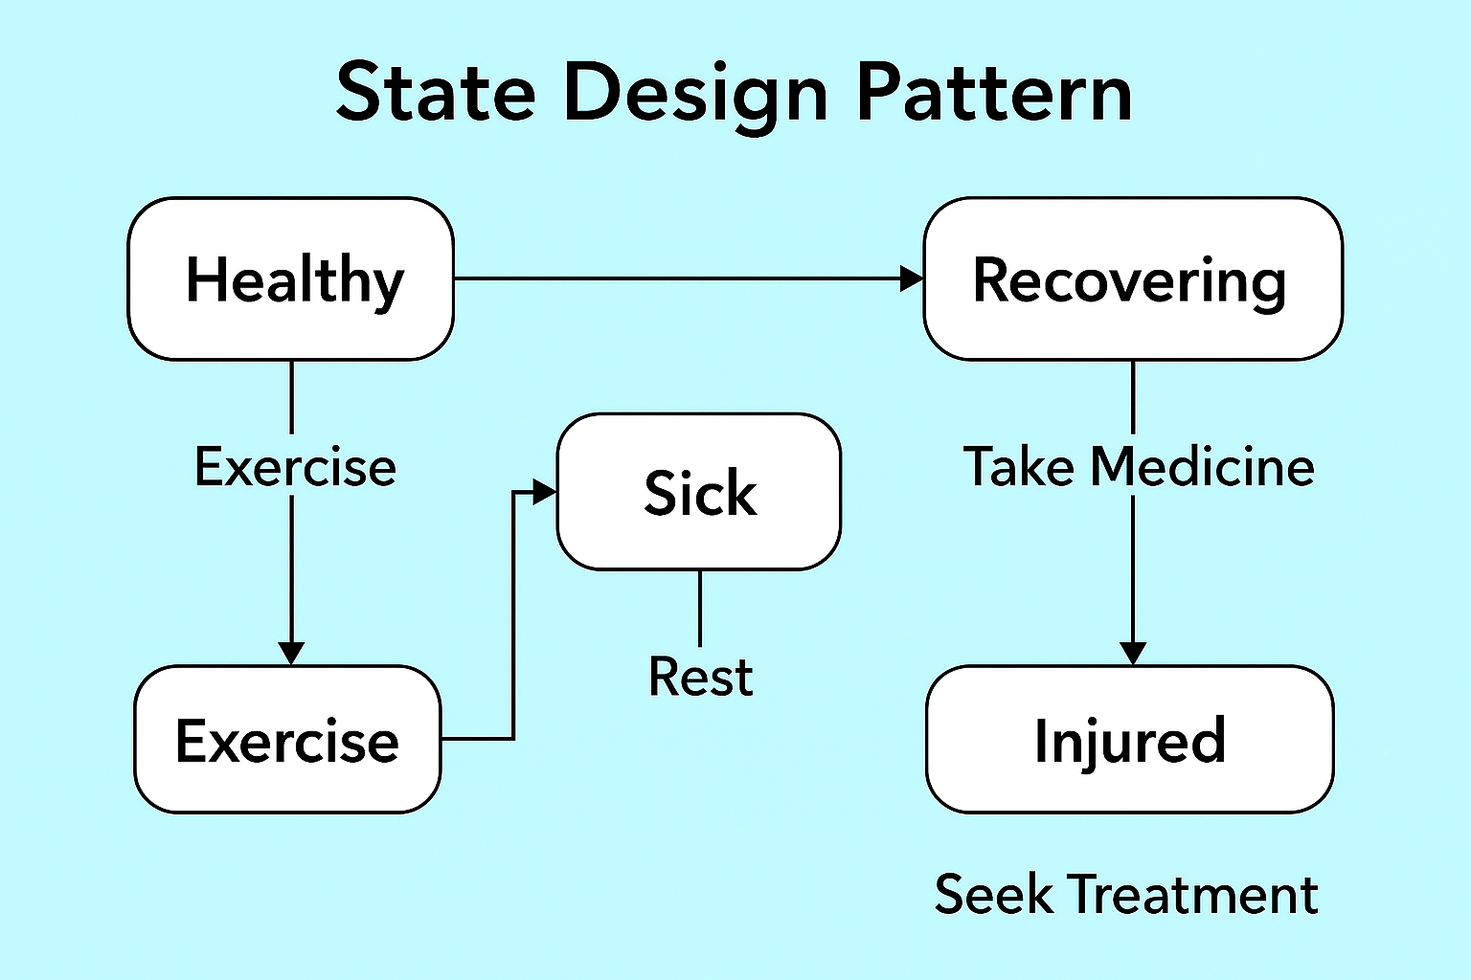

Slide 24
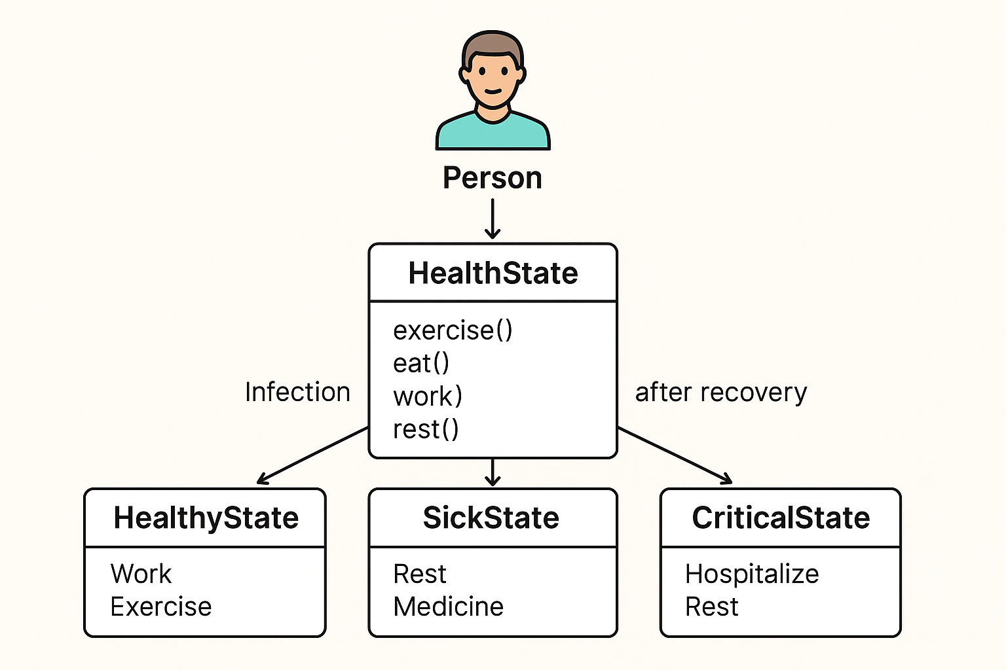

Slide 25
🔑 Key Considerations
Context–State Relationship
The Context (e.g., Person) holds a reference to the current state object.
State transitions should ideally be encapsulated within state classes, not exposed directly by the context.
Encapsulation of Behavior
Each state class should define only the behavior valid in that state.
Avoid writing conditional logic (if/else or switch) in the context; let polymorphism handle it.
State Transitions
Ensure clear rules for transitions (who controls them? the context or the state?).
Transitions should be explicit but not scattered across multiple classes.
Number of States
Works best when an object has well-defined finite states (Healthy, Sick, Critical).
If states are too many or fuzzy, the pattern can overcomplicate.
Extensibility
Adding a new state should require minimal changes to existing code.
This is one of the biggest benefits of the pattern.
Avoiding State Explosion
If you have too many states and transitions, complexity may rise quickly.
Use grouping or hierarchical states to simplify.
Performance Considerations
Each action involves delegation to a state object.
Usually negligible, but in performance-critical systems, you may need to weigh this overhead.

Slide 26
✅ In your health-state example:
The Person (Context) delegates behavior (work(), rest(), exercise()) to the current HealthState.
Each state (Healthy, Sick, Critical) defines what actions are possible.
Transitions (e.g., Sick → Critical, Sick → Healthy) are handled inside state classes, keeping logic clean.

Slide 27
📊 When to Use vs. When Not to Use
✅ When to Use | ❌ When Not to Use
An object’s behavior changes significantly depending on its state (e.g., Person is Healthy, Sick, or Critical). | Object has very few states and behavior doesn’t change much (simple if conditions are enough).
You want to eliminate complex if-else or switch statements that check states repeatedly. | The number of states is too large, leading to state-class explosion and complexity.
States are well-defined, finite, and stable (don’t change frequently). | States are dynamic, fuzzy, or unbounded, making state separation impractical.
You want better organization and readability by putting state-specific logic in separate classes. | Project is small/simple and using multiple classes will add unnecessary overhead.
The system requires easy extension (e.g., adding a new state without modifying existing code). | Extending states is rare, so the pattern brings more cost than benefit.
State transitions are part of the domain model and should be made explicit. | State transitions are trivial and don’t justify separate state classes.
Useful in workflow systems, game characters, devices, user accounts, health states where actions depend on current state. | Not suitable when all behaviors are almost the same regardless of state.

Slide 28
👉 Rule of Thumb
If you find yourself writing long chains of if (state == …), the State Pattern is a good fit.
If states are few and unlikely to change, stick with simpler logic.

Slide 29
Reflective Questions
How does the State Design Pattern improve code organization compared to using multiple if-else or switch statements?
Can you think of a real-world example (outside the classroom) where the State Pattern could simplify handling different behaviors of an object? Why would this pattern be useful there?
What are the potential drawbacks of using the State Pattern in a system, and how can a developer decide whether it is worth applying in a given situation?

